Slide 1
La Roche College Scholar Program Enrollment
January 2018

Slide 2
Why should I consider College in High School?
Benefits for YOU:
Take classes for college credit, while you are in high school
Begin your college transcript before your freshmen semester
Reach sophomore/junior status earlier
This could help you schedule earlier!
Complete certain college requirements, opens schedule up for other interests (or lighter load)
Open space to earn an additional minor
Cost effective: Cheaper than a credit at most universities($210)!

Slide 3
Materials needed for enrollment day
TOMORROW, we will begin to register process together.
Here is what you MUST bring with you:
Social security number
Cell phone (makes it faster and easier)
Parent’s valid email address (if under 18)
College in High School is voluntary, but you must complete this step, if you think that you may want to do it.

Slide 4
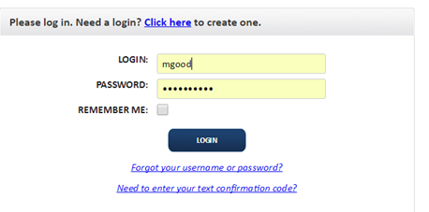
Step by step for students…
Go to laroche.dualenroll.com (no www)
Click here to create an account

Slide 5
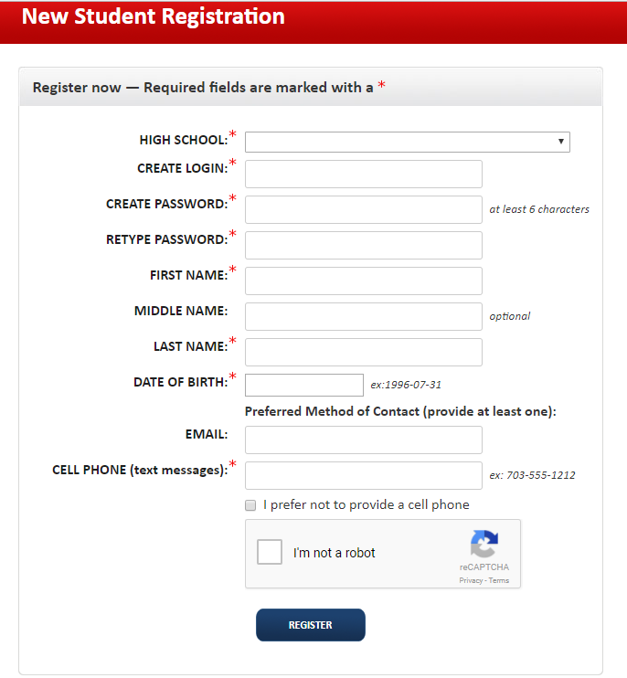
Use North Allegheny SHS
Use NA email for logon and NA password (You must remember these, because we cannot reset it).
Use CELLPHONE # for code. It comes through almost immediately, so that you can continue (may take a few minutes especially depending on service).
Do NOT check “I prefer not to provide a cell phone” unless you want to use email.

Slide 6
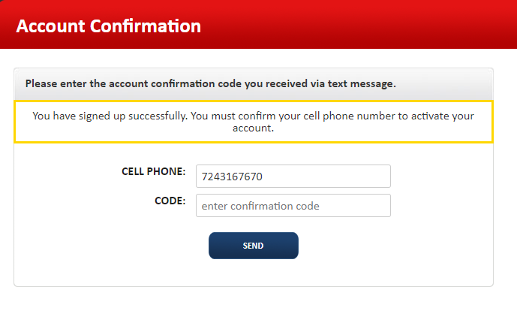
Enter the code sent via text message

Slide 7
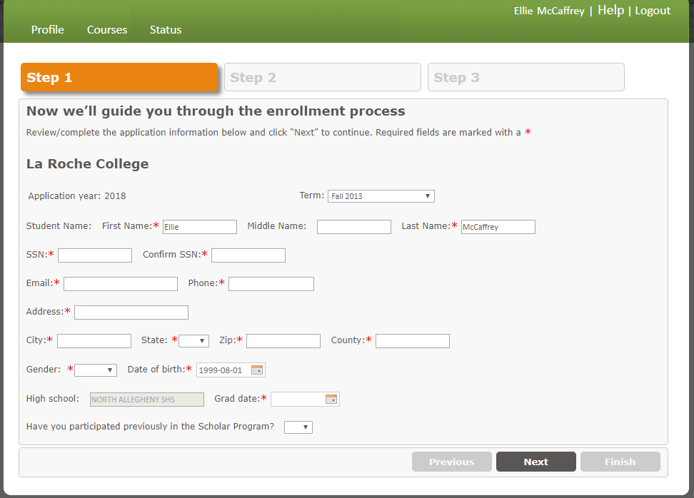

Slide 8
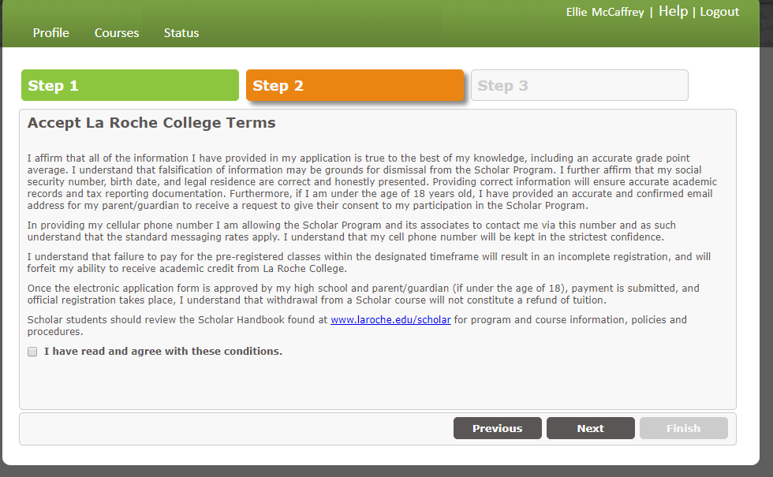

Slide 9
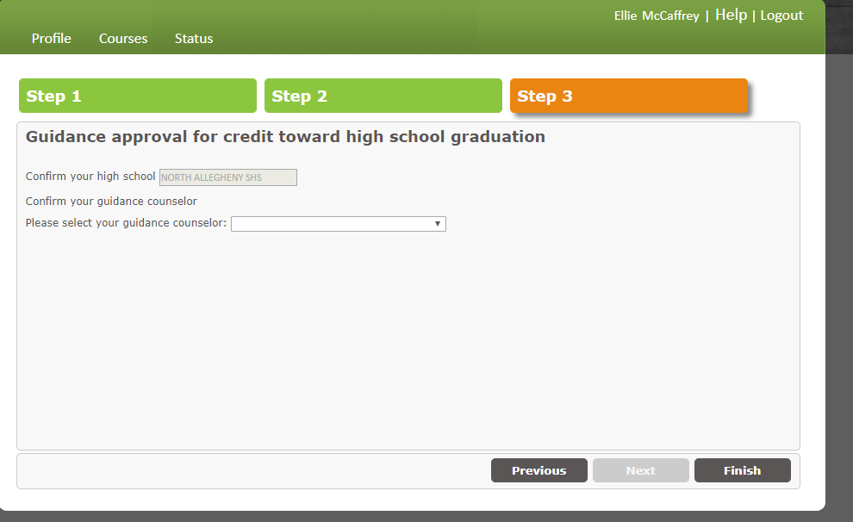
In drop down menu make sure you choose me as the teacher of the class. This is the only way that I can approve you! (The program may call me your Guidance Counselor.)

Slide 10
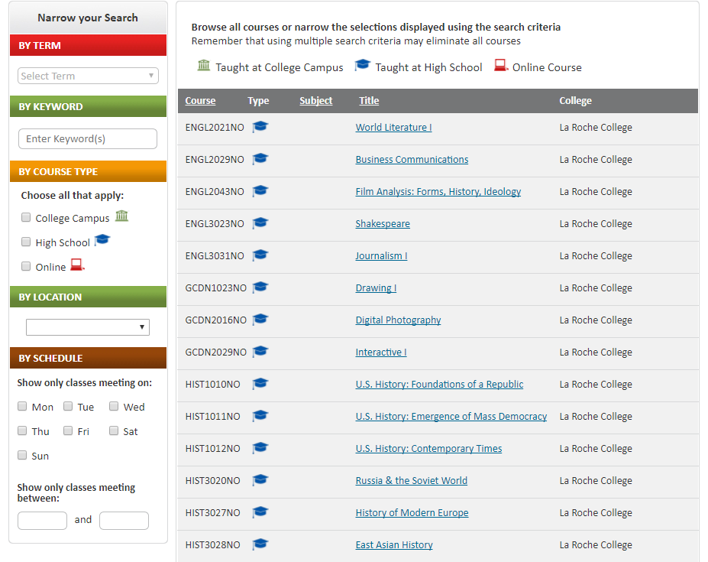
Select course.
And finally make sure to REGISTER----NOT SAVE!

Slide 11
DEADLINES---Non-negotiables
Fall Only/First Semester Courses
Students must register and pay by JANUARY 24th
This new agreement with La Roche started this month.
Fall courses have a very short turnaround.
Second Semester Courses and Year-long Courses
Pre-registration/Application - January 5-March 1, 2018
All Approval Processes & Final Payment Deadline – April 1, 2018
Transcripts will not be generated until June, regardless of the course.

Slide 12
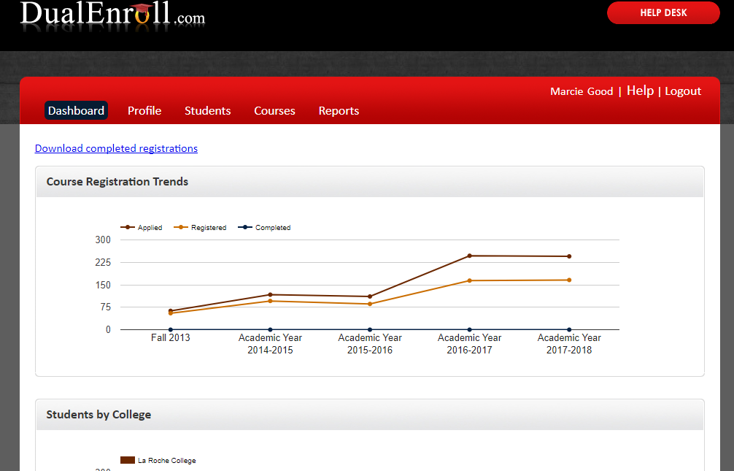
Teacher view
FINAL STEP FOR TEACHERS:
Log into the home page with credentials given to you by Leah Conway
Click on students
View by step
Complete each step for each student
Approval
GPA

